Slide 1
NEO4J CYPHER TUTORIAL WITH PYTHON
Data Analysis From Neo4j Graph Using Pandas
Tutorial 79

Slide 2
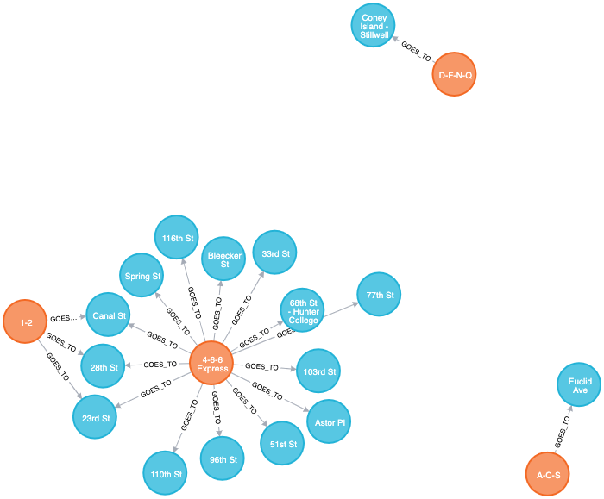
Sample Graph For NEW YORK METRO

Slide 3
USE CASE 1
STATION NAMES FOR EVERY TRAINS

Slide 4
USE CASE 2
TRAIN NAMES FOR EVERY STATIONS

Slide 5
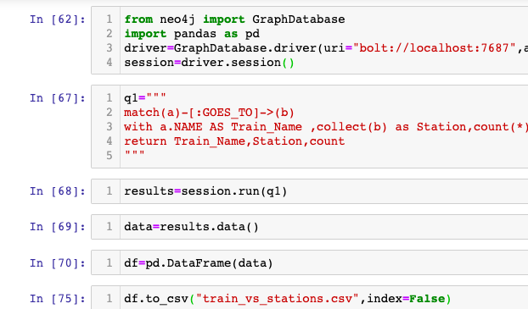
code
Use case 1

Slide 6
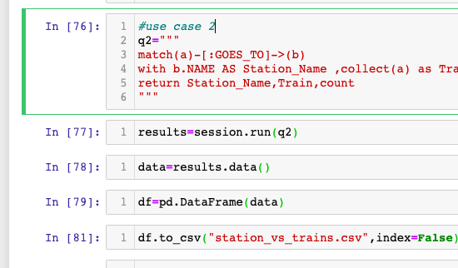
code
Use case 2

